Slide 1
Towards real-time fall detection for edge computing with the LMU
Iain Barkley and Kathryn Simone

Slide 2
The problem

Slide 3
Experiment design
Hidden layer
1000 neurons
(d = n x q)
Output
Node
(d = 1)
Input features
(n = 9)
LDN bank
(q = 20)
KFall labelled data set
9 input features (Acc., Gyr., Euler)
32 subjects
15 Fall tasks + 20 Non-Fall tasks
approx. 5 trials/task
80% of data used for training
m₁
...
m_{n}
‘hidden layer’ has random encoders, decoders were solved for to optimize the mapping of LDN outputs to labels on training data

Slide 4
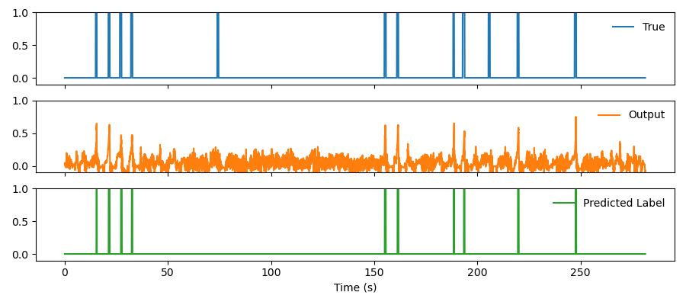
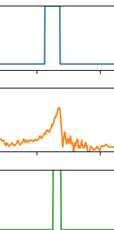
Performance on test data example

Slide 5
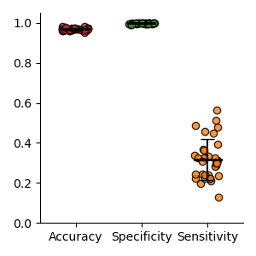
Performance across all individuals
 | LMU | ConvLSTM
Accuracy | 96.7% | 99.3%
Specificity | 99.6% | 99.0%
Sensitivity | 31.6% | 99.3%
https://doi.org/10.3389/fnagi.2021.692865

Slide 6
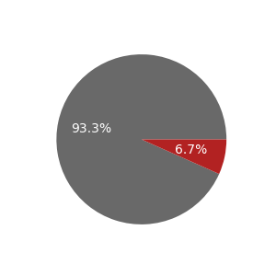
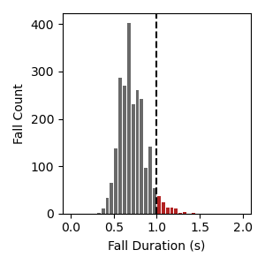
Optimizing θ
Samples included
Samples excluded

Slide 7
Optimizing LDN order q

Slide 8
Optimizing LDN bank size n

Slide 9
Performance with improved parameters

Slide 10
Extra slides
Definition of performance metrics

